Slide 1
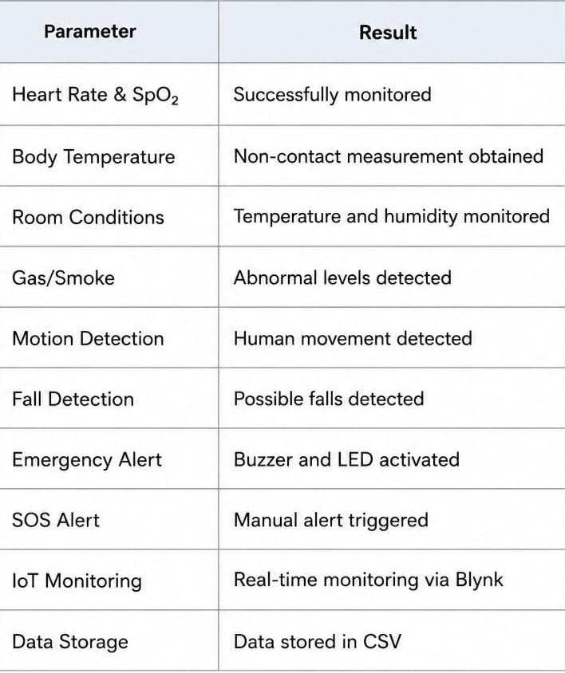
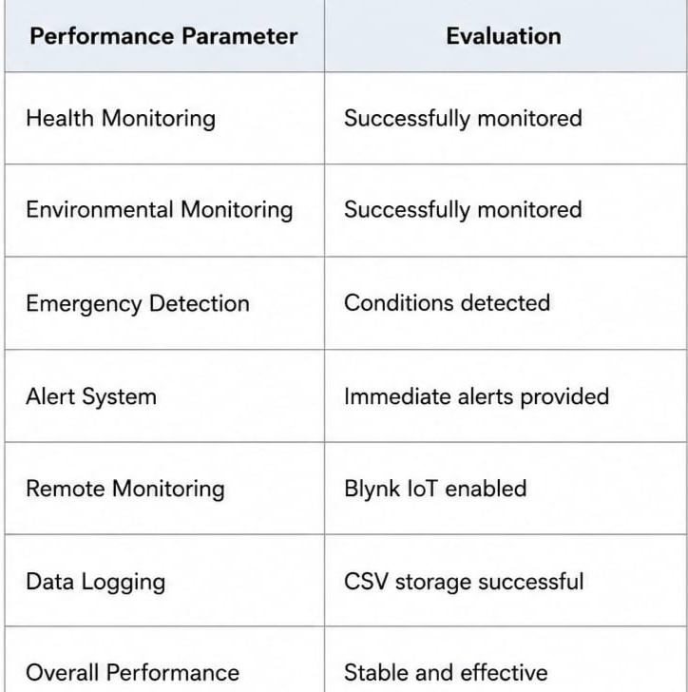
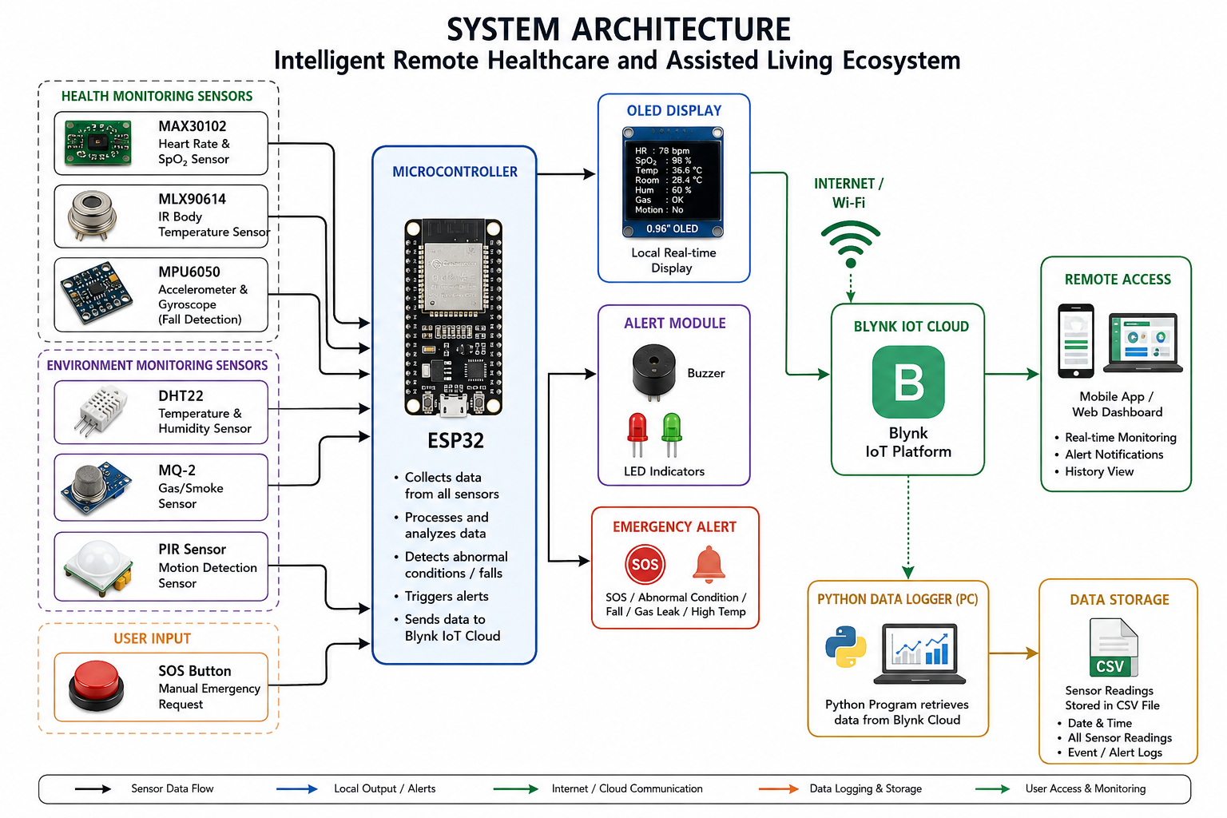
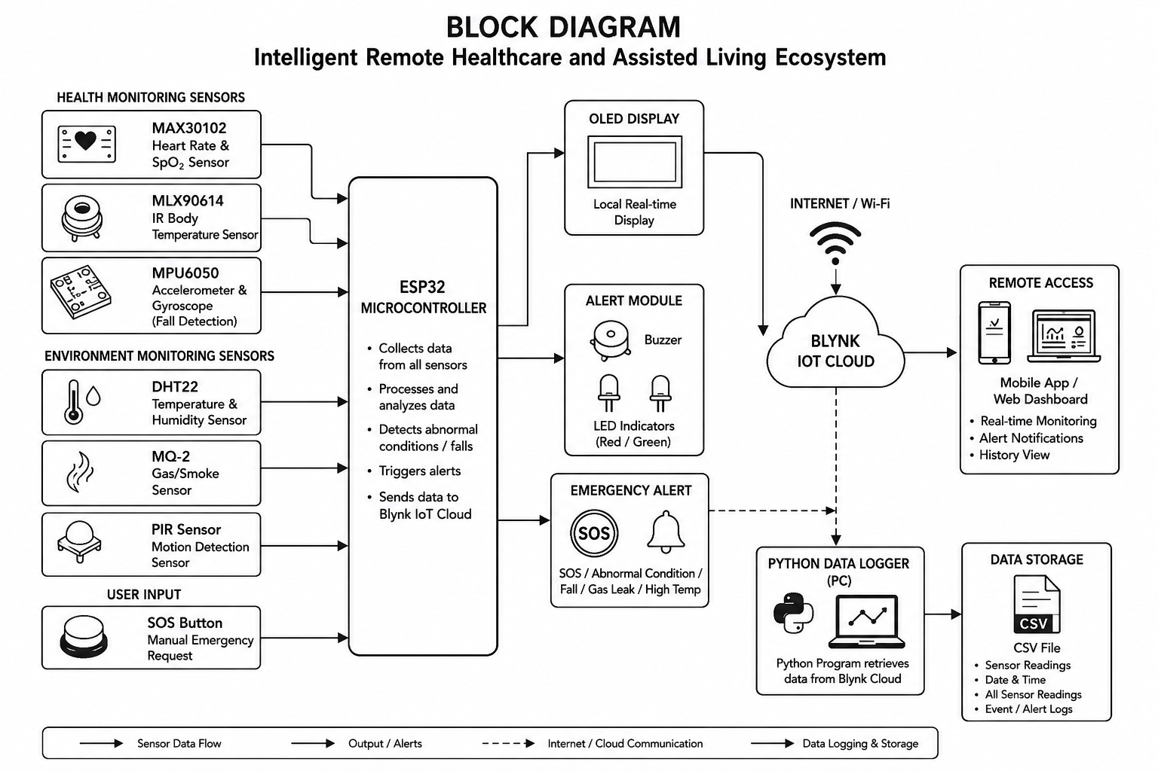

INTELLIGENT REMOTE HEALTHCARE AND ASSISTED LIVING ECOSYSTEM
Project Abstract
This project develops an Intelligent Remote Healthcare and Assisted Living Ecosystem for continuous health, safety, and environmental monitoring. An ESP32 collects data from sensors such as MAX30102, MLX90614, MPU6050, DHT22, MQ-2, and PIR to monitor vital signs, body conditions, movement, and surroundings. The sensor data is displayed on an OLED and transmitted to the Blynk IoT platform for remote monitoring. Abnormal conditions and possible falls trigger buzzer and LED alerts, while an SOS button provides emergency assistance. A Python-based data logging system stores sensor readings in CSV format for future analysis. The system is affordable, reliable, and useful for elderly people, patients, and individuals requiring regular assistance.
Problem Statement
Elderly people, patients, and individuals requiring regular assistance may not always have family members or caregivers available for continuous monitoring. Sudden health changes, falls, gas leakage, smoke, or other emergency situations may therefore go unnoticed. There is a need for an integrated and affordable system that can monitor health and environmental conditions, provide emergency alerts, enable remote access, and maintain records of monitored information.
Need for the Project
The project is needed to provide continuous health and safety monitoring, detect possible emergencies, support remote supervision by family members and caregivers, and maintain useful health and environmental records through automatic data logging.
Project Objectives
Expected Learning Outcomes
System Requirements
Hardware: ESP32 microcontroller, MAX30102, MLX90614, MPU6050, DHT22, MQ-2, PIR sensor, OLED display, buzzer, LED indicators, SOS button, power supply, and connecting wires.
Software: Arduino IDE, Embedded C/C++, Blynk IoT Platform, Python, and CSV data storage.
Methodology / Workflow
Sensors → ESP32 → Data Processing → OLED + Blynk IoT → Emergency Detection → Alerts → Python Data Logging → CSV Storage
System Architecture
Block Diagram
Project Development Process
Problem Identification → Literature Survey → System Design → Sensor Integration → ESP32 Programming → Blynk IoT Integration → Emergency Alerts → Data Logging → Testing → Result Analysis → Conclusion
Implementation
Algorithms / Models Used
Algorithm / model 1: Multi-Sensor Health and Environmental Monitoring
Algorithm / model 2: Abnormal Condition and Fall Detection
Dataset / Input Data (if applicable)
Sensor readings such as heart rate, SpO₂, body temperature, humidity, gas levels, and movement are used as the input data.
Experimental Setup
The ESP32 is connected to the MAX30102, MLX90614, MPU6050, DHT22, MQ-2, and PIR sensors to collect health and environmental data. The readings are displayed on an OLED and transmitted to Blynk IoT for remote monitoring, while the buzzer, LED, and SOS button provide emergency alerts..
Results
Performance Evaluation
Testing and Validation
The proposed system is tested by comparing sensor readings under normal and abnormal conditions. The system successfully monitors health and environmental parameters, detects possible falls and emergencies, provides alerts, and transmits data to the Blynk IoT platform for remote monitoring.
Challenges Encountered
Challenge 1: Achieving accurate and reliable readings from multiple health and environmental sensors.
Challenge 2: Detecting abnormal conditions and possible falls accurately while minimizing false alerts.
Solutions Implemented
Solution 1: Integrated multiple sensors with the ESP32 for reliable health and environmental monitoring..
Solution 2: Used Blynk IoT, buzzer, LED, and SOS button to provide remote monitoring and quick emergency alerts.
Innovation / Novel Features
Integrates health, environmental, and safety monitoring into a single IoT-based system, combining real-time sensor monitoring, fall and emergency detection, remote Blynk monitoring, SOS assistance, and automatic data logging for assisted living.
Applications
Future Scope
The system can be further developed with AI-based health prediction, improved fall detection, mobile notifications, cloud-based long-term health records, and additional medical sensors for more accurate and intelligent remote healthcare monitoring.
Project Outcomes
Provides an integrated platform for health, environmental, and safety monitoring, with remote access through Blynk IoT, emergency alerts, SOS assistance, and automatic data storage for future analysis.
Skills Acquired
Technical skill 1: ESP32 programming, sensor integration, IoT-based monitoring, fall detection, emergency alert systems, and Python-based data logging..
Soft skill 1: Problem Solving, Teamwork, Communication, and Practical Design Thinking.
To develop an ESP32-based system for health and safety monitoring.
To detect health abnormalities, falls, gas leakage, and environmental changes.
To provide remote monitoring, emergency alerts, and automatic data logging.
Gain practical knowledge of ESP32, sensor interfacing, IoT monitoring, and emergency alert systems.
Develop skills in Python-based data logging, CSV storage, testing, and sensor data analysis.
Elderly and Patient Monitoring
Remote Healthcare and Assisted Living
The system uses an ESP32 to collect health and environmental data from multiple sensors. The readings are displayed on an OLED and sent to the Blynk IoT platform for remote monitoring. Abnormal conditions trigger buzzer and LED alerts, while an SOS button provides emergency assistance. Python-based data logging stores the readings in CSV format for future analysis.
References
“Health Monitoring System Design of IoT-based Multi-Physiological Parameters with STM32,” IEEE Conference Publication, 2024..
“A Smartphone-Enabled Fall Detection Framework for Elderly People in Connected Home Healthcare,” IEEE Network, 2019, pp. 58–63.
Acknowledgements
Department of Mechanical Engineering, Knowledge Institute of Technology, Salem.
Project Guide and Team Members for their valuable guidance and support
[QR Code]
QR Code — Project Report (PDF) | Source Code Repository | Demonstration Video
Contact information
Department of Mechanical Engineering, Knowledge Institute of Technology, Salem
Email: 2k23me100@kiot.ac.in | www.kiot.ac.in

